Slide 1
Data Mining
Stephen Mouring
10/23/2015

Slide 2
What is Data Mining?

Slide 3

A discipline of Artificial Intelligence

Slide 4
A branch of Machine Learning

Slide 5
So what is Data Mining?
(Those last two slides did not help…)

Slide 6



Automated ways to find relationships
in data

Slide 7
Data Mining focuses on three types of relationships

Slide 8
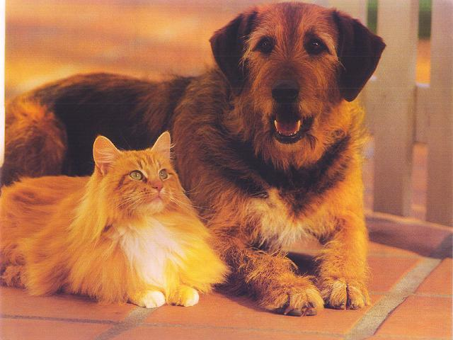
Classification
Is this thing an X or a Y?

Slide 9
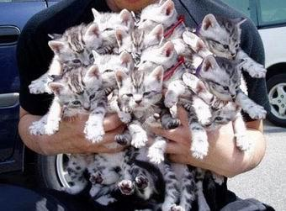
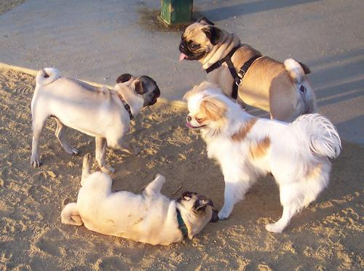
Clustering
← Put these things here
and those things there →

Slide 10
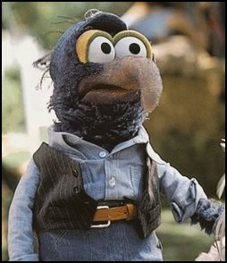
Anomaly Detection
What the heck is this!?

Slide 11
Why Data Mining?

Slide 12
Data Mining is different approach to solving hard problems

Slide 13
Data
vs
Logic

Slide 14
Instead of writing complex and hard to maintain logic
(Hard)

Slide 15
Turn your problem into data
(Easy)

Slide 16
Then leverage data mining for a solution
(Profit!)

Slide 17
Example

Slide 18
Consider playing Chess

Slide 19
<I talk for a long time here…>

Slide 20
Real World Example

Slide 21
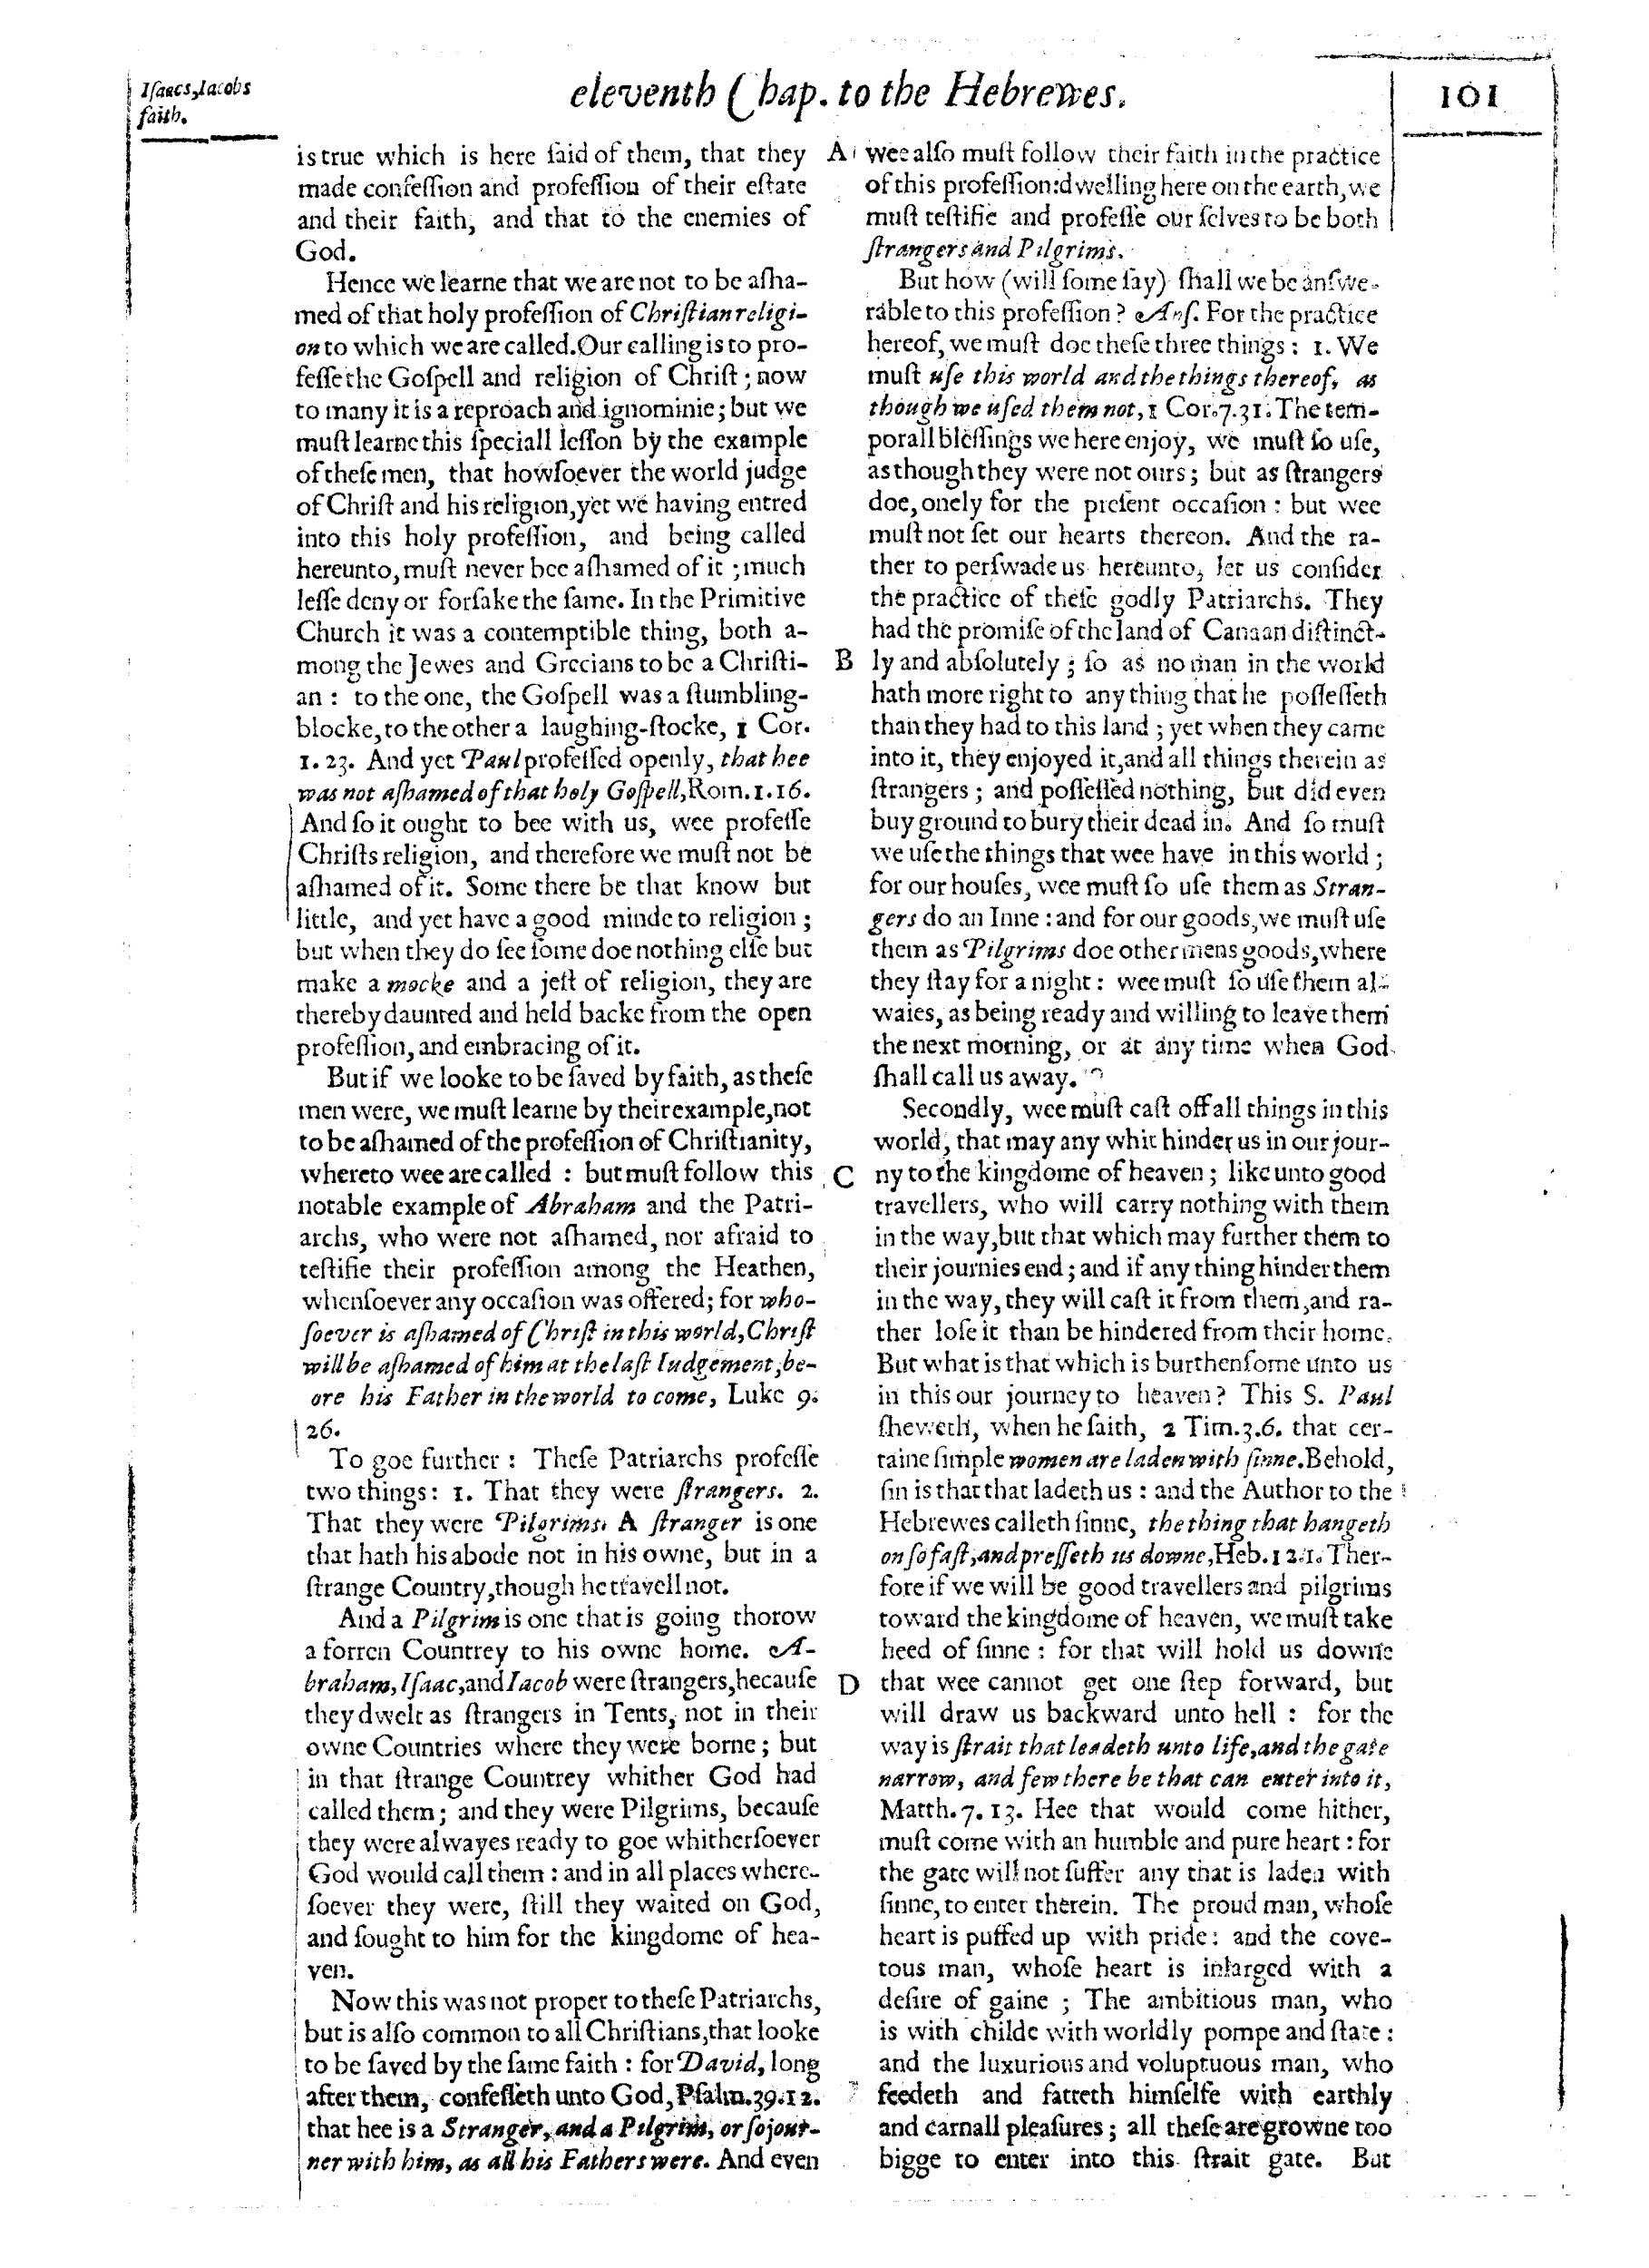
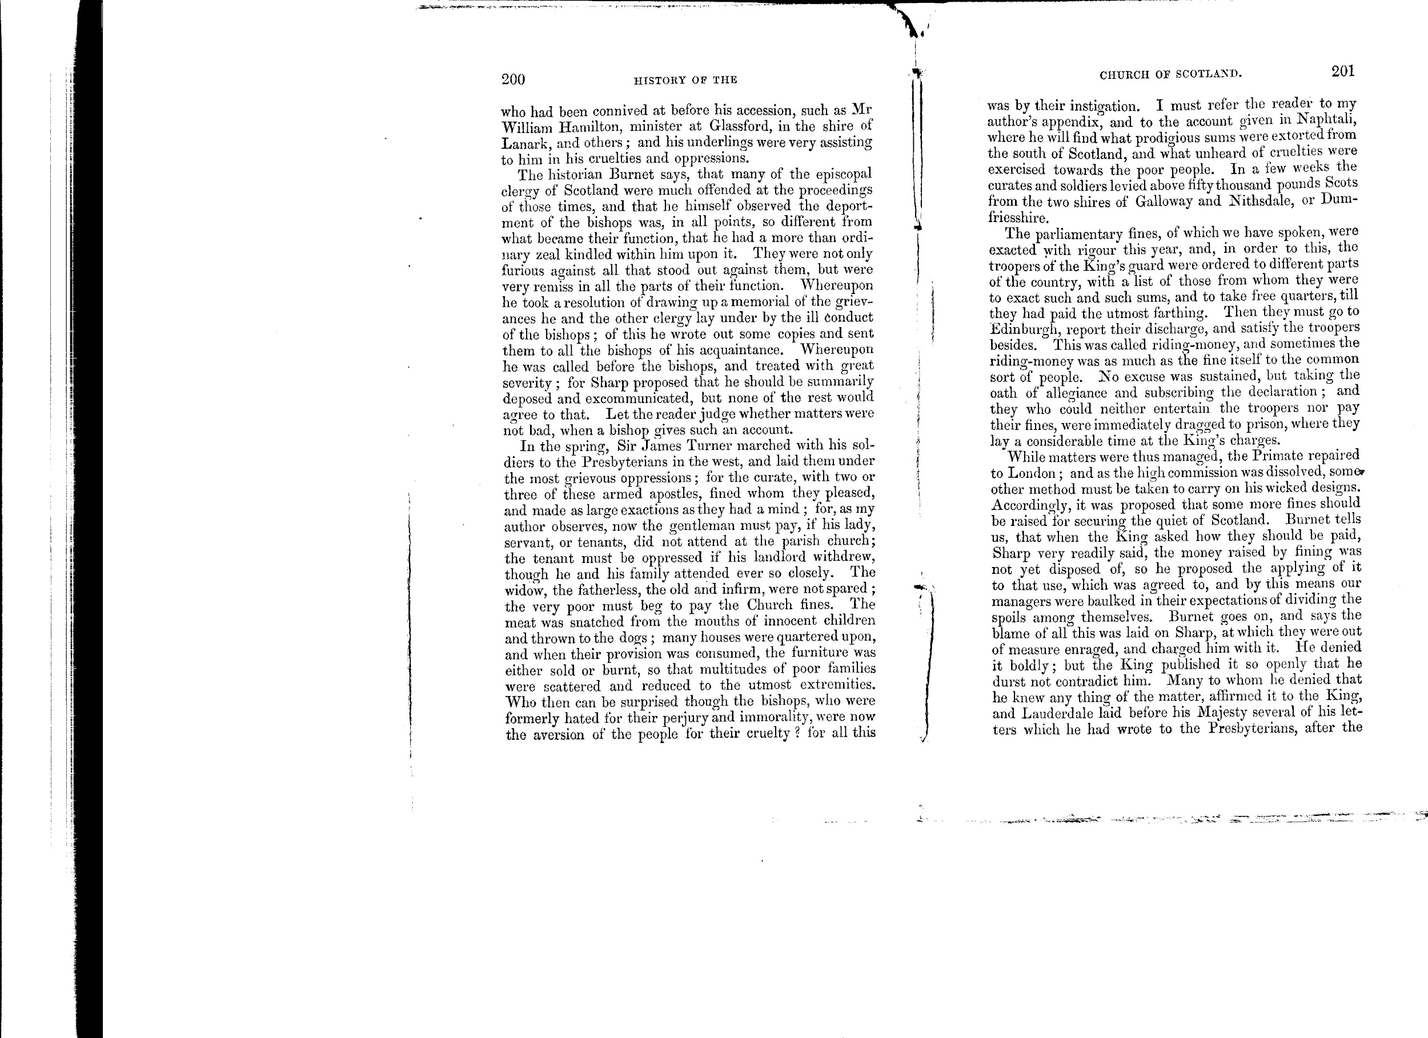

Slide 22
(This was my life before college…)

Slide 23
Column detection
“Artifact” detection and removal

Slide 24
Page detection
“Artifact” detection and removal (this time with margins)

Slide 25
A Closer Look

Slide 26
Classification

Slide 27
Goal: Label a record with a “class”
(Terminology Alert)

Slide 28
Supervised Learning

Slide 29
Has to build a model with known data to predict class of unknown data

Slide 30
Unsupervised Learning
(We have to figure it out as we go along)

Slide 31
Has to build a model without known data or even knowledge of how many classes there are.

Slide 32
Algorithm Example: Decision Tree

Slide 33
Two Phases: Model Building
Classifying

Slide 34
(1) Training set.
(Hint: You can make one!)

Slide 35
(2) Use “a method” to divide set into groups.
(Different methods have different properties.)

Slide 36
(3) Tree:
Nodes are questions
Links are answers
Leaf Nodes are classes

Slide 37
To use: Just repeat.

Slide 38
Pros: Fast classification, easy to implement.

Slide 39
Cons: Slow tree building, irreducible error, overfitting, missing features.

Slide 40
Example

Slide 41
Of Blobs and Characters...

Slide 42
Blob:
Contiguous group of black pixels.

Slide 43
Attributes:
Top / Left / Bottom / Right Normalized
Height / Width
# Black Pixels
Density
“Bridges” - (Number of times there are other blobs within two pixels)

Slide 44
Class Label:
Artifact or Character

Slide 45
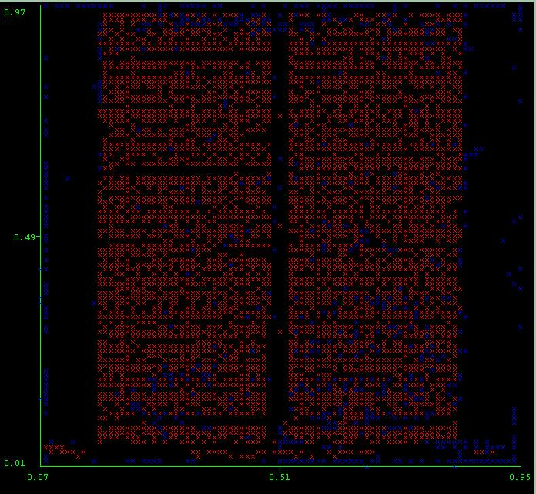

Slide 46
if (numBlack <= 13) {
if (numBlack <= 8) {
// Yes
delete = true;
} else {
if (vertExtent <= 5) {
if (leftNorm <= 0.83) {
if (topNorm <= 0.54) {
// Yes
delete = true;
} else {
if (horzExtent <= 5) {
// No
} else {
// Yes
delete = true;
}
}
} else {
// Yes
delete = true;
}
} else {
// Yes
delete = true;
}
}
} else {
if (rightNorm <= 0.18) {
if (topNorm <= 0.58) {
if (rightNorm <= 0.08) {
// Yes
delete = true;
} else {

Slide 47
Conclusion: Accuracy improved two fold

Slide 48
Decision Tree is one of many algorithms...

Slide 49
Clustering

Slide 50
Goal: To group records with the same class label

Slide 51
Example Algorithm: K-Means

Slide 52
Pictures

Slide 53
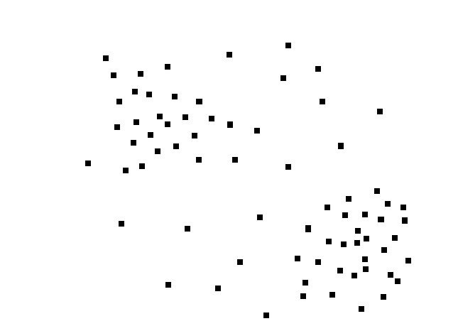

Slide 54
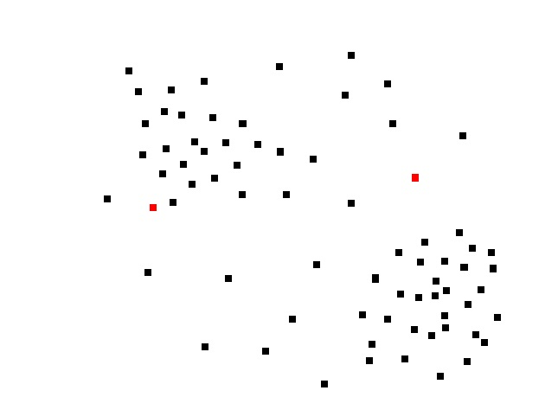

Slide 55
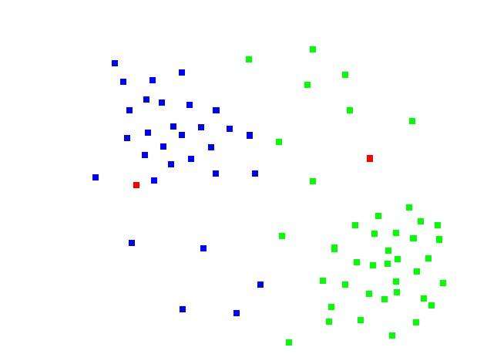

Slide 56
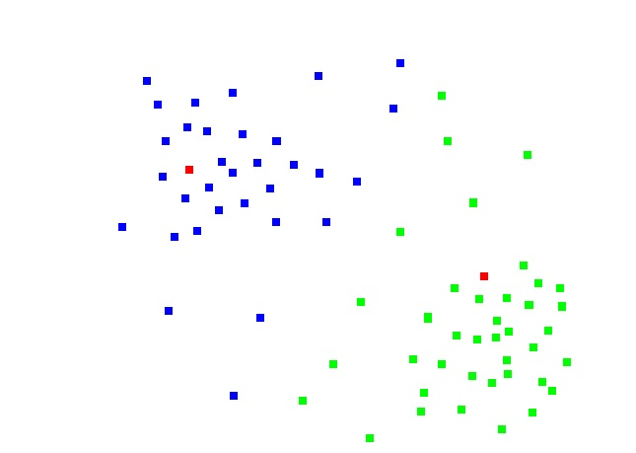

Slide 57
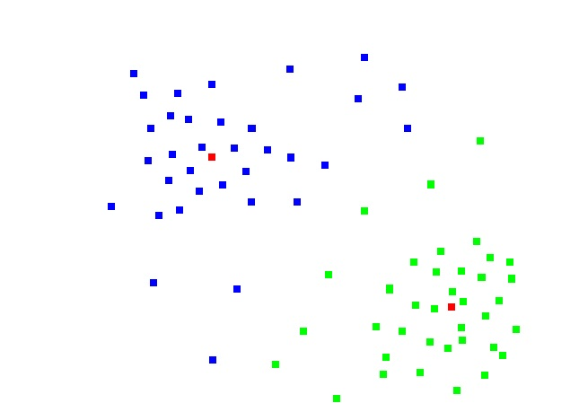

Slide 58
Pros: Simple, flexible definition of distance, ideal for round clusters

Slide 59
Cons: No outlier detection, must know k, cannot handle contours

Slide 60
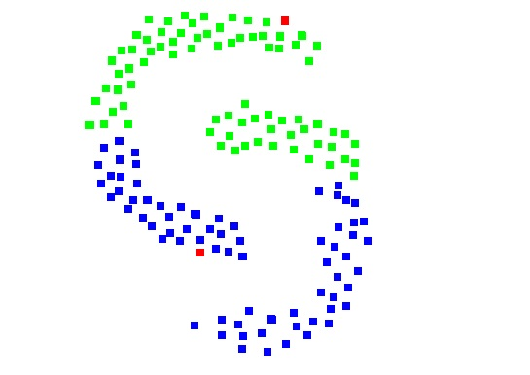

Slide 61
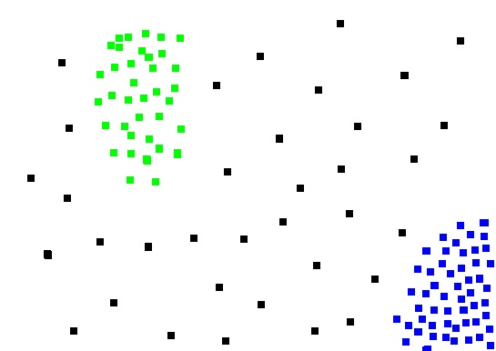

Slide 62
Example Algorithm: DBScan

Slide 63
Pictures

Slide 64


Slide 65
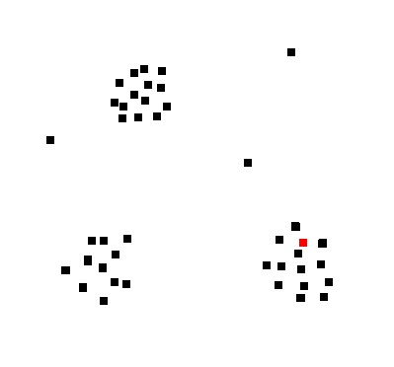

Slide 66
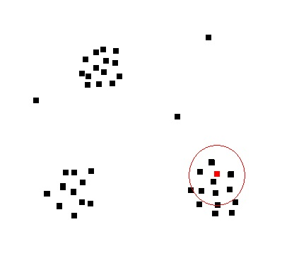

Slide 67
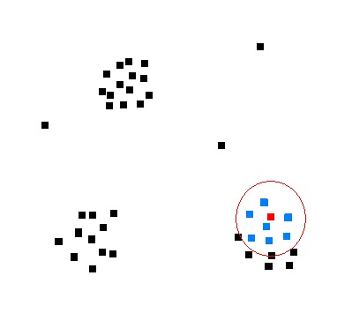

Slide 68
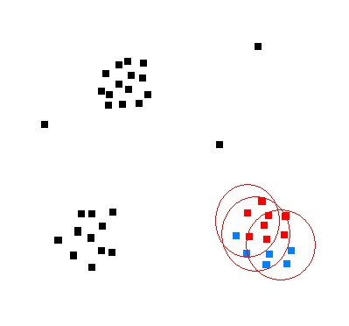

Slide 69
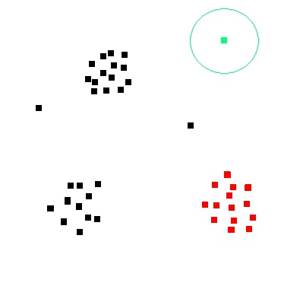

Slide 70


Slide 71
Pros: Contour and density compatible, flexible definition of distance, unsupervised, outlier detection

Slide 72
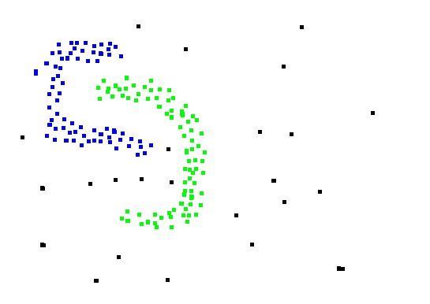

Slide 73
Cons: Hard to parallelize, requires frequent traversals of data

Slide 74
Anomaly Detection

Slide 75
Can be a mirror of clustering

Slide 76
(There are also dedicated algorithms)

Slide 77
Some techniques: “surprise” functions, distance

Slide 78
Some problems: 99.99999% not good enough, false positives or false negatives?

Slide 79
Maybe another time...

Slide 80
Questions??

